Slide 1
Software QA and Testing with Automation using Selenium IDE Course 2, Class 1
Instructor
David F Wagoner
PMP, CSQE, CMQ/OE

Slide 2
A Note
We touched on testing methods and types in the previous course. In this course we will expand on those concepts
This course involve automation using the Python language with hooks into MS Access for test data using our final web site developed in the previous course
This course uses more lab time than lecture to code and implement automation between Selenium, Python and MS Access using ODBC

Slide 3
Configuration Testing
What is Configuration Testing?
This involves testing at varied levels:
PC Workstations
PC Workstations are connected to myriad devices, Iphones, mp3 players, portable drives, monitors, DVD recorders, wired and wireless networks…etc.
Testing a PC configuration is not trivial but it is a small part of overall configuration testing because of the level of standardization in that industry
There can be ‘givens’ that X will work on Y machine but the important point for our focus is on critical interfaces that are user facing and part of the application depends upon

Slide 4
Compatibility Testing
The more important aspect of configuration testing is focused on the web browser the app intends to support and the platforms for which the app is intended
Browser (IE, Firefox, Chrome…etc.)
Platforms (workstation, tablet, phone)
OS (Linux, Windows, Android)
These are the elements you focus on as a web developer

Slide 5
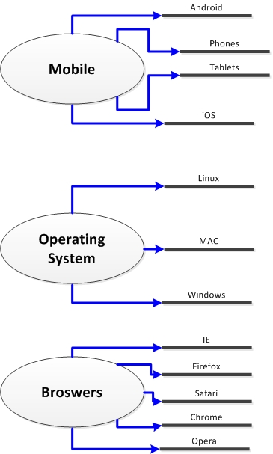
Today’s Complexity

Slide 6
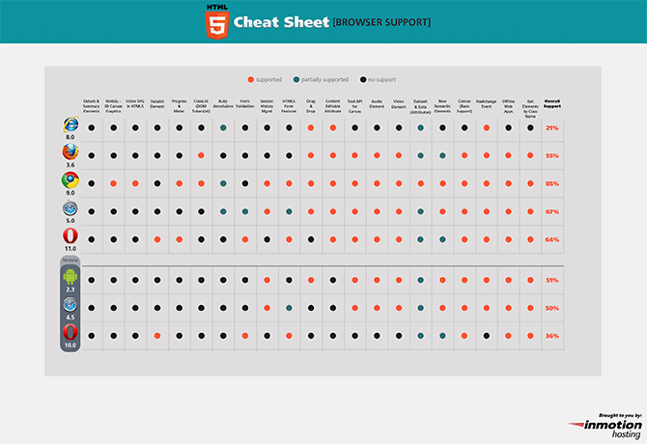
Web Site Testing (cont.)
Many online resources to identify browser compatibility and test a browser to detect compatibility
http://caniuse.com/; http://mobilehtml5.org/; http://html5readiness.com/

Slide 7
Compatibility (cont.)
As web site testers you do not need to be concerned with equipment compatibility, you will be focused more on compatibility among disparate resources
Are different database engines or servers involved?
Are web services involved?
Is the app interconnected in a business flow to other sites not controlled by you? Is it part of a supply chain?
Are different file formats involved and do they translate properly?

Slide 8
Usability Testing
This is one of the less concrete, abstract aspects of testing
As the book asserts, an application that MEETS REQUIREMENTS but is clunky, difficult to use, objects or fields don’t flow together or response times are slow. Even an uneducated user will flag these as
‘Quality Issues’

Slide 9
Usability Testing (cont.)
Although abstract and ‘mushy’, it’s no less important than functional testing and in many ways is more important with web sites
The app can meet requirements but still be unusable
Organizations, like government agencies, that spend millions on new software are quite particular in their expectations – expectations not reflected in business requirements

Slide 10
Usability Testing (cont.)
This can be a sensitive area when critiquing a developers work because they are expressing their ‘artistic’ bent in the UI
Many developers believe they excel at UI design when in fact they don’t
Time for a time-worn axiom
All developers are either artists that want to be engineers or engineers that fancy themselves as artists
Be sensitive to this and above all, kind and diplomatic
If the UI needs rework, bring something along to the discussion to support your case

Slide 11
Usability Testing (cont.)
It is especially important in this area to remember that YOU are the user’s advocate at times when they have no insight
As the first non-developer to touch the system, you should ferret out UI issues on their behalf and the betterment of the app
These can be good ‘learning moments’ between developers and testers

Slide 12
Usability Testing (cont.)
If there is no UI standard in place (and there likely won’t be), create one based on industry standards
Other standards
The application may have to meet other standards like being 508 compliant
Using standards for the UI (or anything really) gives you objectivity and credibility, not to mention being a resource that evolves the app and team

Slide 13
Usability Testing (cont.)
Heuristics
The books gives a good starter list
Intuitive
Does it behave as one would expect given current web site functionality and user experience?
Flexible
Can you go back and forward in a process or will it crash and burn? Users will use an app in every way it was not intended. You should do the same
Consistent
Does it handle similar things the same way. Does one date field pop up a calendar while another requires the user to type in the date in an unknown format?
Comfortable
Is a user able to complete tasks without wanting to throw your app off of a tall building?
Correct
Does it meet requirements while maintaining usability? Does it meet applicable customer or industry standards? Does it implement shortcuts consistently?
Pay attention to language, meaning, spelling and grammar
Useful
Somewhat like Comfortable, can the user complete the tasks intended for the app?

Slide 14
Documentation Testing
At first glance, this appears to be a trivial item
But for systems that require a users manual, operators manual, samples, templates or extensive help, it’s a critical issue
While not a critical factor in site or system quality, it is something heavily relied on when a user experiences problems
The solutions should be close at hand or
The support folks on the help desk become very busy answering questions they shouldn’t have to field
Eventually, like with MS products, it creeps into perceptions of quality

Slide 15
Documentation Testing (cont.)
The benefits of documentation testing are:
Improves overall system usability and reliability
Reduced support costs
IF the documentation is accurate, well-structured and readable (spelling, grammar and concise text)
Remember these points for occasions when time is short and managers want to short-shrift documentation to meet deadlines

Slide 16
Documentation Testing (cont.)
What’s involved in documentation testing?
The setup can be fairly intensive in terms of setup
While test environments can and are often used, that can be problematic with data focused on testing showing up in screen shots
A mature test organization can handle having dual-purpose test environments, which is more cost efficient
Having separate test and documentation environments is more costly but easier to manage and can make for faster testing

Slide 17
Documentation Testing (cont.)
What’s involved in documentation testing?
General
Audience
Knowing the audience and how they perceive information including concepts, business terms, jargon and keywords
Content
Often, the help of a subject matter expert (SME) is necessary

Slide 18
Documentation Testing (cont.)
What’s involved in documentation testing?
Assess the system and ensure documentation reflects:
Concise information
Step by step direction
Figures and screen captures (especially!)
Samples and Templates
Spelling and grammar
Error messages

